Slide 1
Advanced Systems Analysis and Design Data Modelling SOFT 30121 L7

Slide 2
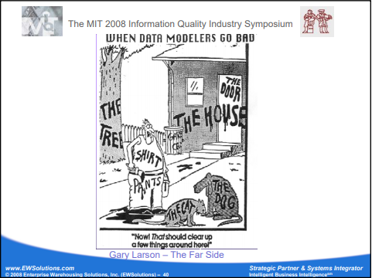
Data Modelling
RecoSystems Analysis and Design
Alan Dennis; Barbara Haley Wixom; Roberta M. Roth
2019
Chapter 6

Slide 3
Data Modelling
Objectives of Lecture 9
Explain the rules and style guidelines for creating entity relationship diagrams (ERDs).
Explain the difference between crows foot notation and UML Notation in class diagrams.
Create an ERD.
Describe the process of normalization.
SOURCE: RecoSystems Analysis and Design
Alan Dennis; Barbara Haley Wixom; Roberta M. Roth
2019
Chapter 6

Slide 4
Data Model
A data model is a formal way of representing the data that are used and created by a business system; it illustrates people, places, or things about which information is captured and how they are related to each other.
The data model is drawn by an iterative process in which the model becomes more detailed and less conceptual over time. During analysis, analysts draw a logical data model, which shows the logical organization of data without indicating how data are stored, created, or manipulated.
In the design phase, analysts draw a physical data model to reflect how the data will physically be stored in databases and files. At this point, the analysts investigate ways to store the data efficiently and to make the data easy to retrieve.

Slide 5
Entity Relationship Diagram
An entity relationship diagram (ERD) is a picture which shows the information that is created, stored, and used by a business system. An analyst can read an ERD to discover the individual pieces of information in a system and how they are organized and related to each other.
On an ERD, similar kinds of information are listed together and placed inside boxes called entities. Lines are drawn between entities to represent relationships among the data, and special symbols are added to the diagram to communicate high‐level business rules that need to be supported by the system.
The ERD implies no order, although entities that are related to each other are usually placed close together.

Slide 6
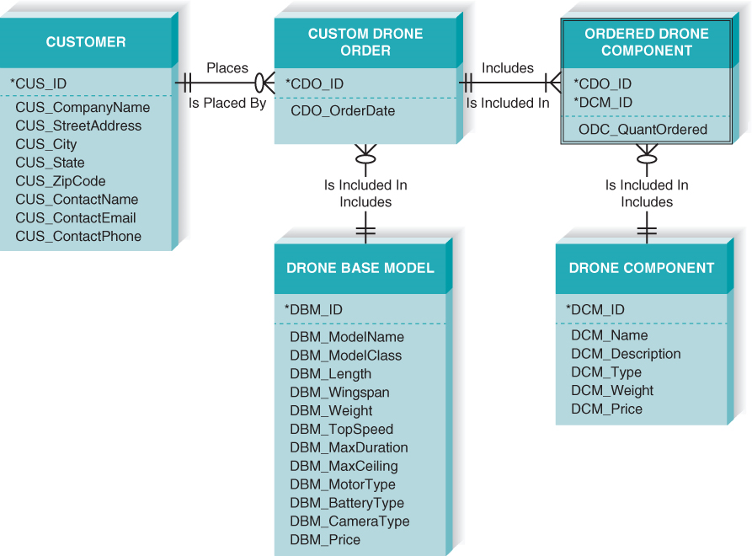
Developing an Entity Relationship Diagram

Slide 7
Developing an Entity Relationship Diagram
Step 1: Identify the Entities
Step 2: Add Attributes and Assign Identifiers
Step 3: Determine Composition
Step 4: Identify Relationships
Step 5: Determine Cardinality
Step 6: Determine Modality
Step 7: Resolve Intersection Entities
Step 8: Confirm Normalization Rules

Slide 8
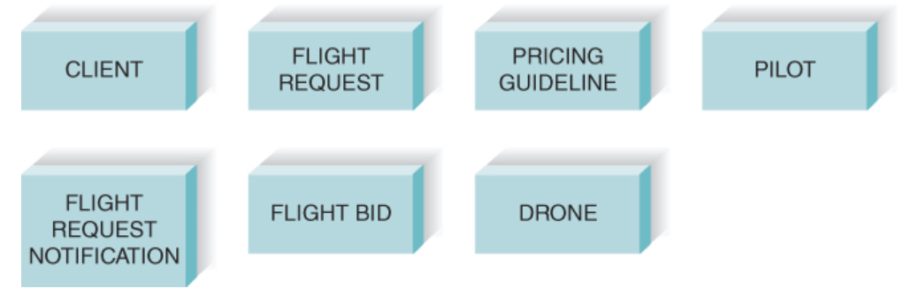
Step 1: Identify the Entities
The entity is the basic building block for a data model. It is a person, place, event, or thing about which data is collected—for example, an employee, an order, or a product. An entity is depicted by a rectangle, and it is described by a singular noun spelled in capital letters. All entities should have a name and a short description that explains what they are.

Slide 9
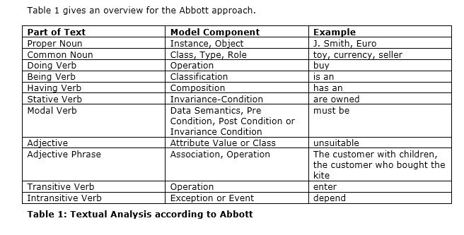
Textual Analysis
Picking out the common nouns from interview notes is a great way to get a first cut at the entities.

Slide 10
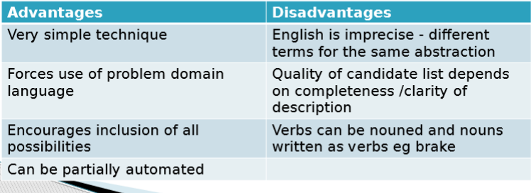
Textual Analysis

Slide 11
Step 2: Add Attributes and Assign Identifiers
An attribute is some type of information that is captured about an entity. For example, last name, home address, and e‐mail address are all attributes of an employee. It is easy to come up with hundreds of attributes for an entity (e.g., an employee has a specific eye color, a favorite hobby, a religious affiliation), but only those that actually will be used by a business process should be included in the model.

Slide 12
Sidebar conversation
“Attributes are nouns that are listed within an entity. Usually, some form of the entity name is appended to the beginning of each attribute to make it clear as to what entity it belongs (e.g., CUS_CompanyName, CUS_StreetAddress). Without doing this, you can get confused by multiple entities that have the same attributes—for example, a Drone Base Model and a Drone Component both can have an attribute called “Weight.” DBM_Weight and DCM_Weight are much clearer ways to name attributes on the data model.”
Oracle’s data modelling standards discouraged this. Customer.First_Name is quite clearly different from Employee.First_Name. Only where you had similar attributed on the same entity would this be recommended: Order_Line.Ordering_UOM, Order_Line.Shipping_UOM

Slide 13
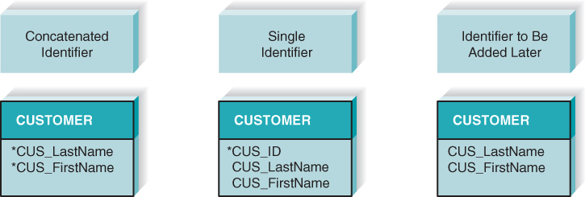
Step 2: Add Attributes and Assign Identifiers
You can use a combination of multiple fields to serve as the identifier (last name and first name). This is called a concatenated identifier because several fields are combined, or concatenated, to uniquely identify an instance. Second, you can find a field that is unique for each instance, like the customer ID number. Third, you can wait to assign an identifier

Slide 14
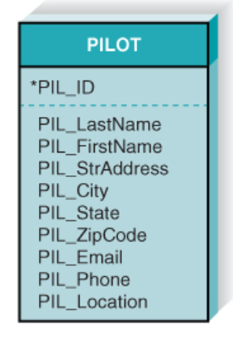
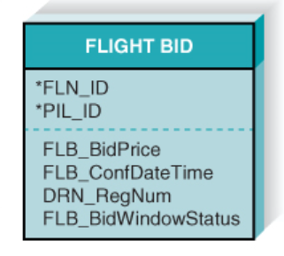
Step 3: Determine Composition
There are situations when a child entity does require attributes from the parent entity to uniquely identify an instance. In these cases, the child entity is called a dependent entity, and its identifier consists of at least one attribute from the parent entity.

Slide 15
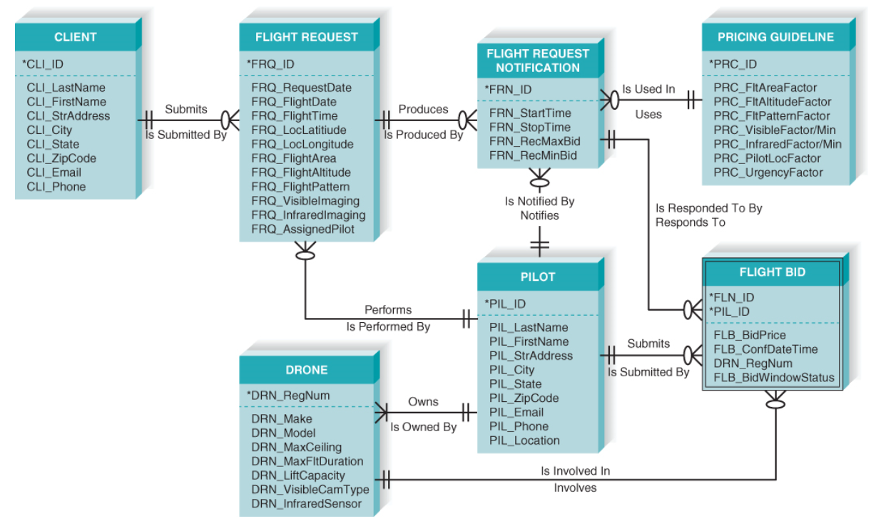
Step 4: Identify Relationships
Lines are drawn between entities that have relationships, and each relationship is labeled and assigned a cardinality and modality.

Slide 16
Step 5: Determine Cardinality
A Client entity instance may submit many Flight Request entity instances, while a Flight Request entity instance is submitted by one Client entity instance.

Slide 17
Step 6: Determine Modality
A Client entity instance does not require a related Flight Request entity instance, but a Flight Request entity instance does require a related Client instance.

Slide 18
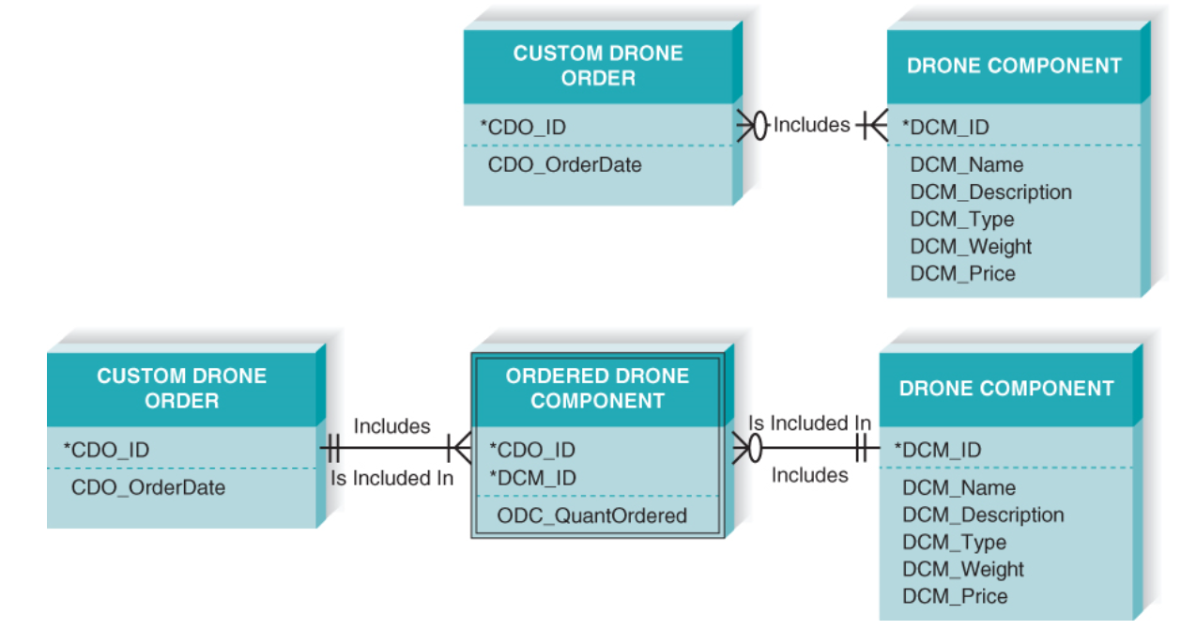
Step 7: Resolve Intersection Entities
An important special kind of entity is the intersection entity. It exists in order to capture some information about the relationship between two other entities. Typically, intersection entities are added to a data model to store information about two entities sharing an M:N relationship.

Slide 19
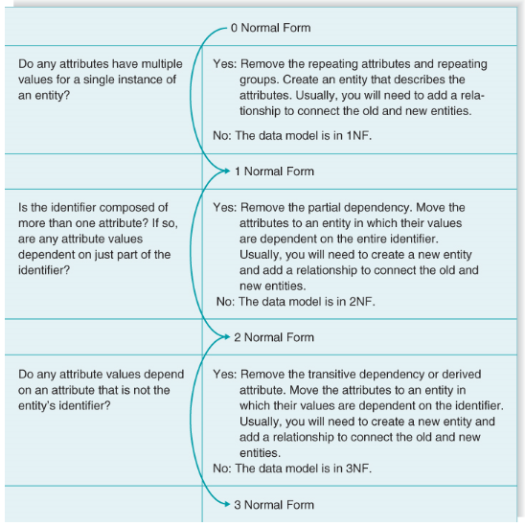
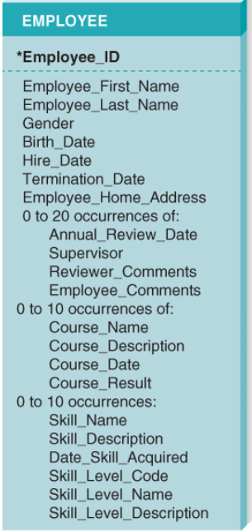
Step 8: Confirm Normalization Rules

Slide 20
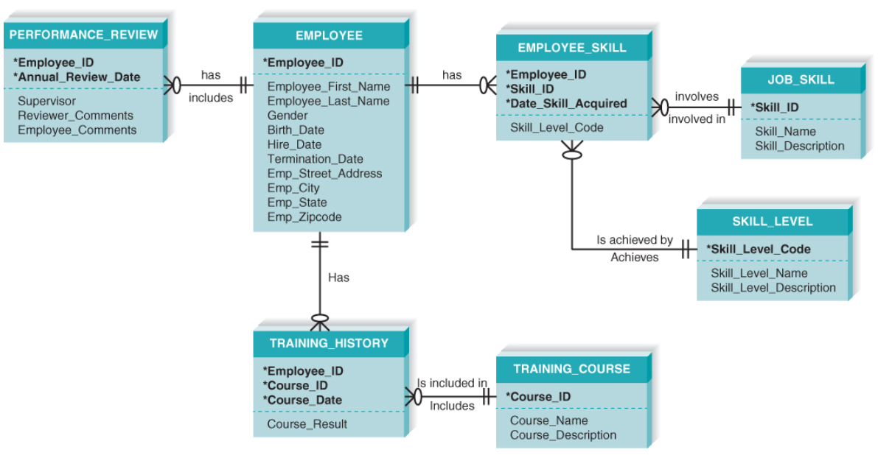
Step 8: Confirm Normalization Rules

Slide 21
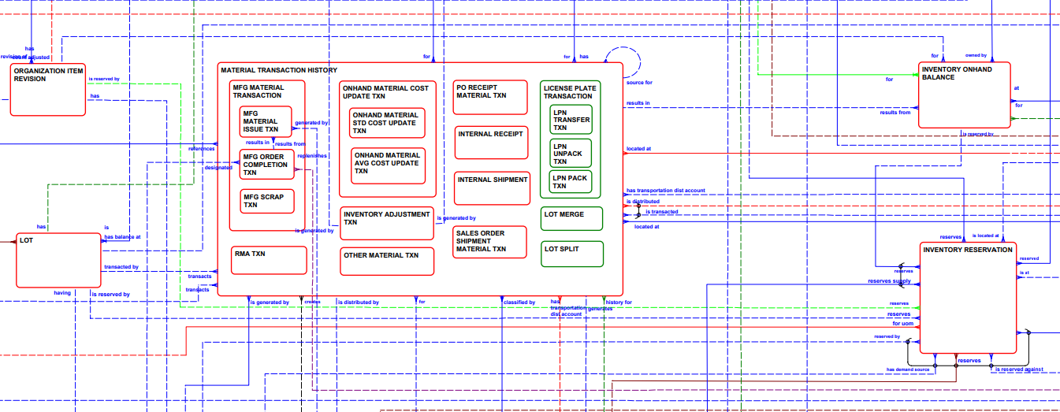
A real data model example

Slide 22
UML vs Crows Foot notation
They are basically the same thing
UML Class diagrams are more modern than Crows foot.
Some may think that UML has more precision in its relationship notation.
Relationship vs dependency
Number of instances vs “Many”
I find the Crows foot notation much easier to read because the multiplicity and modality are part of the relationship symbol.
Some may feel that the UML Static Class notation is richer because it can represent composition. This cannot be represented in Crow’s Foot. This notion is useful in determining transaction boundaries, which in turn helps you design screens.
I basically think in crows foot notation. I have to translate to UML.

Slide 23
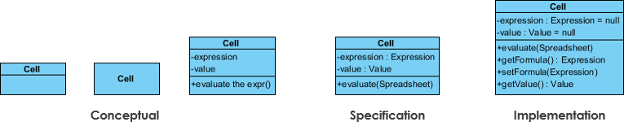
UML Class Diagram Notation refresher
Class Notation

Slide 24
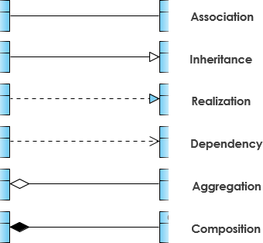
UML Class Diagram Notation refresher
Relationship Notation

Slide 25
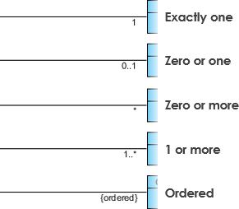
UML Class Diagram Notation refresher
Multiplicity and Modality

Slide 26
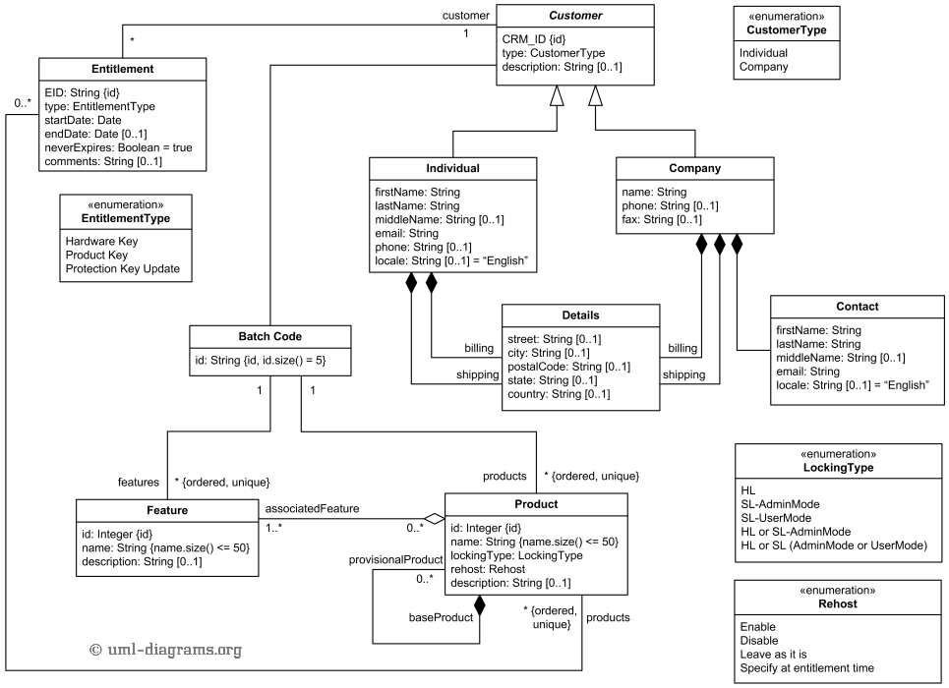
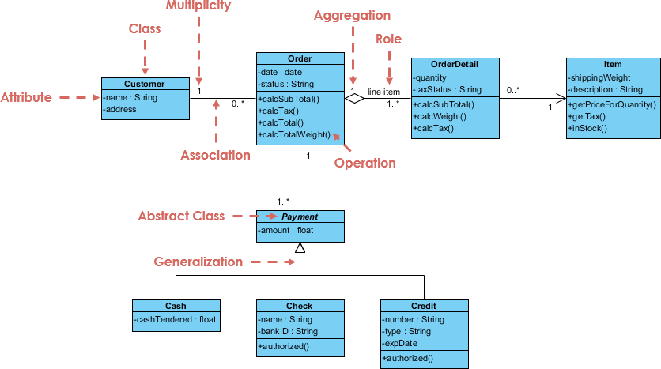
UML Class Diagram Example

Slide 27
Data Modelling
Objectives of Lecture 9
Explain the rules and style guidelines for creating entity relationship diagrams (ERDs).
Create an ERD.
Explain the difference between crows foot notation and UML Notation in class diagrams.
SOURCE: RecoSystems Analysis and Design
Alan Dennis; Barbara Haley Wixom; Roberta M. Roth
2019
Chapter 6

Slide 28
Next Lecture
Transitioning to Design

